Slide 1
Assign: a software for single-cell genomic data integration
Weiqiang Zhou
Assistant Scientist
Department of Biostatistics

Slide 2



From bulk to single cell
Cell sample
Bulk sequencing
(e.g. RNA-seq, ATAC-seq)
Average profile
Individual profile
Single-cell sequencing
(e.g. scRNA-seq, scATAC-seq)

Slide 3
Available single cell assays
10x genomics
Single-cell RNA-seq
Single cell immune profiling
Fluidigm
Single-cell RNA-seq
Single-cell ATAC-seq
Single cell CNV
Single-cell DNA-seq
Single-cell ATAC-seq

Slide 4
Single cell multiomics
Macaulay et al. G&T-seq: parallel sequencing of single-cell genomes and transcriptomes. Nature Methods (2015). (G&T-seq: genomic DNA and gene expression)
Hu et al. Simultaneous profiling of transcriptome and DNA methylome from a single cell. Genome Biology (2016). (scMT-seq: DNA methylation and gene expression)
Cheow et al. Single-cell multimodal profiling reveals cellular epigenetic heterogeneity. Nature Methods (2016). (sc-GEM: genotype, DNA methylation, and gene expression; use Fluidigm system)
Clark et al. scNMT-seq enables joint profiling of chromatin accessibility DNA methylation and transcription in single cells. Nature Communications (2018). (scNMT-seq: chromatin accessibility, DNA methylation, and gene expression)
Cao, J. et al. Joint profiling of chromatin accessibility and gene expression in thousands of single cells. Science (2018). (sci-CAR: chromatin accessibility, and gene expression)

Slide 5
Integrate multiple data types
Cell sample
scRNA-seq
scATAC-seq
Single cell with both transcriptome and regulome data

Slide 6
Overview

Slide 7
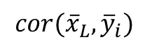

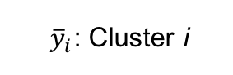
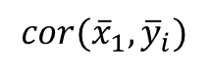
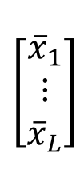
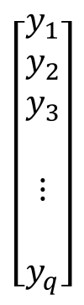


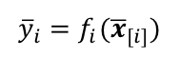



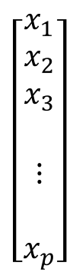
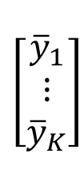
BIRD
$$X$$
$$\left[\begin{aligned}\begin{matrix}x_{1} \\ x_{2} \\ x_{3}\end{matrix} \\ \\ ⋮ \\ \\ x_{p}\end{aligned}\right]$$
$$\left[\begin{matrix}{\overline{x}}_{1} \\ ⋮ \\ {\overline{x}}_{L}\end{matrix}\right]$$
$$\overline{X}$$
$${\overline{x}}_{[i]}$$
Cluster
$${cor({\overline{x}}_{1},\overline{y}}_{i})$$
…
$${cor({\overline{x}}_{L},\overline{y}}_{i})$$
$${\overline{y}}_{i}=f_{i}({\overline{x}}_{[i]})$$
$$Y$$
$$\left[\begin{aligned}\begin{matrix}y_{1} \\ y_{2} \\ y_{3}\end{matrix} \\ \\ ⋮ \\ \\ y_{q}\end{aligned}\right]$$
$$\left[\begin{matrix}{\overline{y}}_{1} \\ ⋮ \\ {\overline{y}}_{K}\end{matrix}\right]$$
$$\overline{Y}$$
${\overline{y}}_{i}$: Cluster i
Cluster
$${\overline{y}}_{i}=f_{i}\left({\overline{x}}_{[i]}\right)=β_{i0}+β_{i1}{\overline{x}}_{\left[i\right]1}+…+β_{iN}{\overline{x}}_{\left[i\right]N}+ε_{i}$$

Slide 8
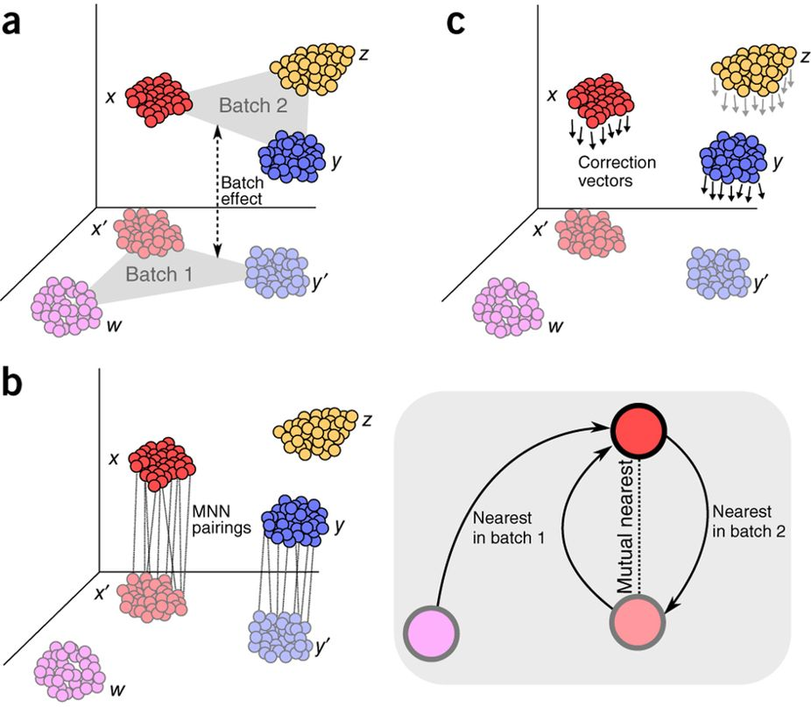
Platform effect removal
Figure obtained from Haghverdi et al. Batch effects in single-cell RNA-sequencing data are corrected by matching mutual nearest neighbors. Nature Biotechnology 36, 421–427 (2018)

Slide 9
Spatial regulation
Predicted scATAC
True scATAC
Before optimization
After optimization
d
Fisher’s extract test:
N_{P_obs}/ N_{T_obs} = N_{P}/ N_{T}

Slide 10
Application to a test dataset
scRNA-seq
scATAC-seq
Predicted + True scATAC-seq
Assign

Slide 11
Comparison with other methods
ASSIGN: 94% correct pairs

Slide 12
Comparison with other methods
MATCHER: 43% correct pairs

Slide 13
Comparison with other methods
Cicero: 79% correct pairs

Slide 14
Comparison with other methods
couple-NMF: 56% correct pairs

Slide 15
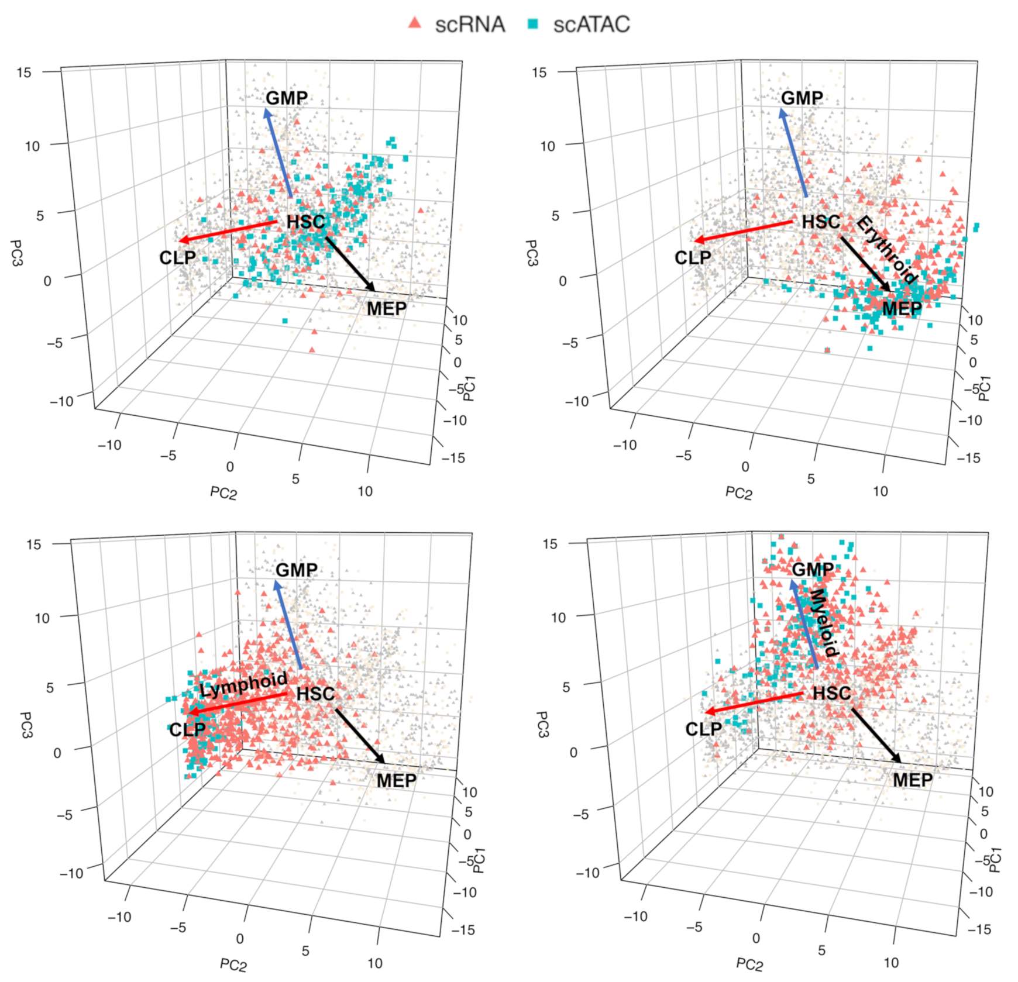
Application to HCA data

Slide 16
Application to HCA data

Slide 17
Application to HCA data
GATA1

Slide 18
Application to HCA data
EBF1

Slide 19
Application to HCA data
CEBPD

Slide 20
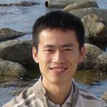
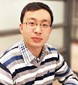

Acknowledgement
Hongkai Ji
Professor,
Department of Biostatistics,
Johns Hopkins Bloomberg School of Public Health
Zhicheng Ji
PhD Candidate,
Department of Biostatistics,
Johns Hopkins Bloomberg School of Public Health
Weixiang Fang
PhD Candidate,
Department of Biostatistics,
Johns Hopkins Bloomberg School of Public Health

